Slide 1
HTML5 Media and Graphic Elements
Prof Maheswari S,
VIT Chennai

Slide 2
HTML5 API’S
HTML Geo location
HTML Drag and Drop
HTML Local Storage
HTML Application Cache
HTML Web Workers
HTML SSE

Slide 3
Media Elements - Audio
Find the type of file extension.
Multimedia file formats : .avi, .mp3, .mp4, .wmv, .mpg, .wav, and, .swf

Slide 4
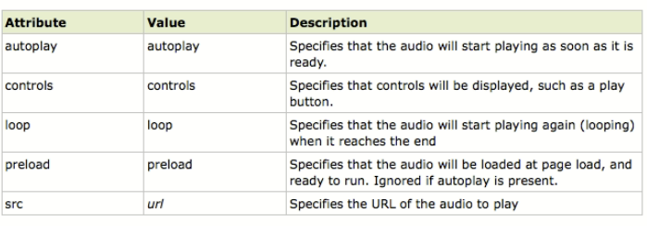
Attributes

Slide 5
Multimedia Elements - Video

Slide 6
Example
<video width = “450” height = “340” controls autoplay>
<source src = “mov.ogg” type = “video/ogg”/>
<source src = “mov.webm” type = “video/webm”/>
Browser does not support the video tag
</video>

Slide 7
Canvas
It uses JavaScript to draw graphics on a web page.
Rectangular area and control every pixel of it.
Several methods - drawing paths, boxes, circles, characters, and adding images.

Slide 8

Syntax
<canvas id="myCanvas" width="200“
height="100"></canvas>
To add border:
<canvas id="myCanvas" width="200" height="100“ style="border:1px solid #000000;">
</canvas>

Slide 9
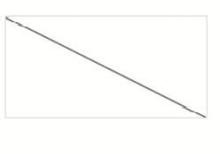
Canvas - Line draw
var c = document.getElementById("myCanvas");
var ctx = c.getContext("2d");
ctx.moveTo(0,0);
ctx.lineTo(200,100);
ctx.stroke();

Slide 10
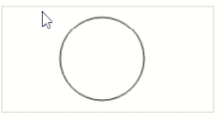
Canvas - Circle
var c = document.getElementById("myCanvas");
var ctx = c.getContext("2d");
ctx.beginPath();
ctx.arc(95,50,40,0,2*Math.PI);
ctx.stroke();

Slide 11
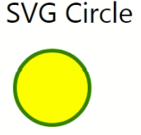
svg
<!DOCTYPE html>
<html>
<body>
<svg width="100" height="100">
<circle cx="50" cy="50" r="40" stroke="green"
stroke-width="4"fill="yellow" />
</svg>
</body>
</html>

Slide 12
Google map
<body>
<h1>My First Google Map</h1>
<div id="map" style="width:400px;height:400px;"></div>
<script>
function myMap() {
var mapOptions = {
center: new google.maps.LatLng(51.5, -0.12),
zoom: 10,
mapTypeId: google.maps.MapTypeId.HYBRID
}
var map = new google.maps.Map(document.getElementById("map"), mapOptions);
}
</script>
</body>

Slide 13
THANK YOU

